Slide 1
MOTHERSHIP vs DRIP and SHIP
SYMTAS 31/05/18
SANTIAGO DE COMPOSTELLA

Slide 2
Prehospital LVO stroke recognition
Transfer protocols
Intrahospital delay : CSC workflow metrics
Mothership = Bypass PSC
Drip and ship optimization
Regional EV Capable stroke centers

Slide 3
DRIP AND SHIP
BYPASS PSC
TRIP AND TREAT

Slide 4
Transfer Delay in Acute Ischemic Stroke Prabhakaran et al Stroke2011
The odds of emergent angiography decreased by 3% (unadjusted
OR, 0.970) per minute of delay beyond 46 minutes
In a multivariable logistic regression model prolonged transfer time remained negatively associated with emergent angiography embolectomy

Slide 5
Transfer related Morbidity/Mortality
In IMS III, the odds of a good clinical outcome (modified Rankin Scale score ≤2) for subjects treated under the drip and ship paradigm are less than the odds for subjects treated under the mother-ship paradigm (odds ratio, 0.56; 95% confidence interval, 0.31–0.99; P=0.045). Goyal et al.Circulation 2014
Hospital transfer associated with increased mortality Rinaldo et al JNIS 2016

Slide 6
Hospital transfer associated mortality Rinaldo et al. JNIS 2016
National database:
reported outcomes of 8533 inpatient admissions for EVT of AIS
On multivariate analysis, distance remained associated with death after adjustment for patient age, NIHSS , basilar occlusion, administration IV t-PA, time to intervention, TICI 2b/3reperfusion grades
Notes:
Distance traveled was found to be signiﬁcantly associated with an increased risk of death among transferred patients

Slide 7
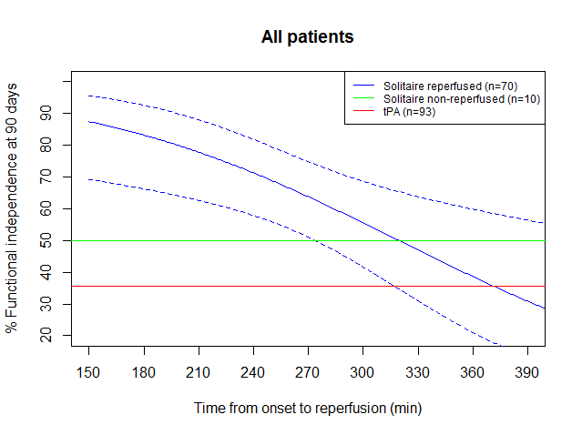
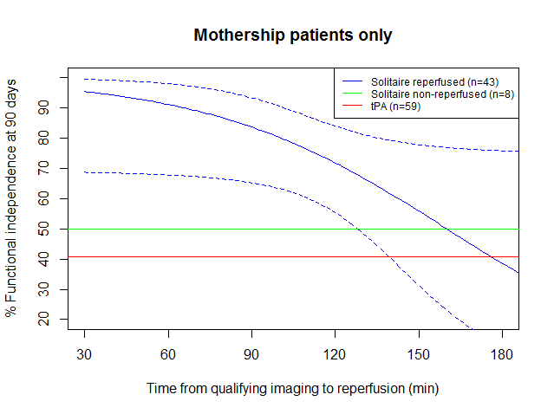
Figure 3: Patient Transfer Type
Goyal et al. Radiology 2016
A
Patients who initially arrived at a referring facility had longer symptom onset to groin puncture times compared with patients who presented directly to the endovascular-capable center (275 vs 179.5 minutes, P , .001).
B
Revascularization within 2.5 hours of symptom onset was associated with functional independence (minimal or no disability) in 91% of patients.
Likelihood of functional independence was 10% higher in patients treated within 2.5 hours compared with patients treated between 2.5 and 3.5 hours after stroke onset.

Slide 8
Major emphasis on speed of treatment
MR CLEAN showed a 7% decreased probability of good outcome for each hour delay in revascularization. For patients revascularized within 2 hours of stroke onset, the absolute difference in good outcomes between the endovascular and control groups was 33%, decreasing to 6.5% at 6 hours.
Time to reperfusion and treatment effect for acute ischemic stroke: a randomized clinical trial. Fransen et al. JAMA Neurol 2016;73:190–6.

Slide 9
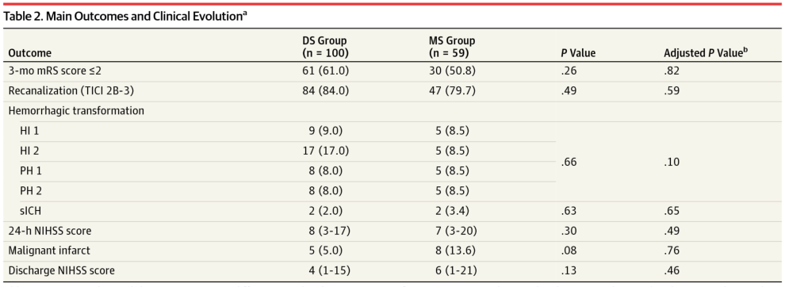
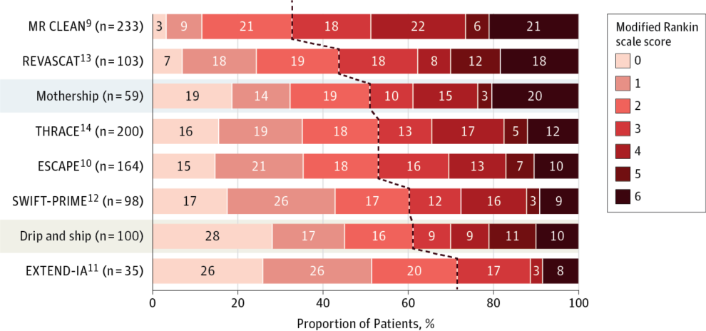
From: Two Paradigms for Endovascular Thrombectomy After Intravenous Thrombolysis for Acute Ischemic Stroke
JAMA Neurol. 2017;74(5):549-556. doi:10.1001/jamaneurol.2016.5823
Notes:
Functional Independence (Modified Rankin Scale Score) at 3 Months Compared With the 6 Positive Clinical Trials Comparing Intra-arterial Therapy After Intravenous Thrombolysis With Intravenous Thrombolysis AloneData are the proportion of patients. Each row represents the result of the intravenous thrombolysis and mechanical thrombectomy group of one of the published studies except for the rows representing the drip-and-ship and mothership groups. The dashed line represents the modified Rankin scale score limit of 2 or less for the main outcome. ESCAPE, Endovascular Treatment for Small Core and Proximal Occlusion Ischemic Stroke; EXTEND-IA indicates Extending the Time for Thrombolysis in Emergency Neurological Deficits–Intra-arterial; MR CLEAN, Multicenter Randomized Clinical Trial of Endovascular Treatment for Acute Ischemic Stroke in the Netherlands; REVASCAT, Randomized Trial of Revascularization With Solitaire FR Device Vs Best Medical Therapy in the Treatment of Acute Stroke Due to Anterior Circulation Large Vessel Occlusion Presenting Within 8 Hours of Symptom Onset; SWIFT-PRIME, Solitaire FR With the Intention for Thrombectomy as Primary Endovascular Treatment for Acute Ischemic Stroke; and THRACE, Trial and Cost Effectiveness Evaluation of Intra-arterial Thrombectomy in Acute Ischemic Stroke.

Slide 10
Mothership :Bypass PSC
Clinical outcomes were better in the direct group with 60.0% (299/498) achieving functional independence, compared to 52.2% (213/408) in the transfer group (odds ratio 1.38, 95%CI 1.06-1.79; p=0.02).
Likewise, excellent outcome (modified Rankin Score 0-1) was achieved in 47.4% (236/498) of direct patients vs. 38.0% (155/408) of transfer patients (odds ratio 1.47, 95%CI 1.13-1.92; p=0.005).
Mortality did not differ between the two groups (15.1% for direct, 13.7% for transfer; p=0.55). IV-tPA did not impact outcomes.
Interhospital Transfer Prior to Thrombectomy is Associated with Delayed Treatment and Worse Outcome in the STRATIS Registry.Froehler et al Circulation 2017

Slide 11
Mothership :Bypass PSC
Hypothetical bypass modeling for all transferred patients suggested that IV-tPA would be delayed by 12 minutes but MT would be performed 91 minutes sooner if patients were routed directly to endovascular-capable centers.
If bypass is limited to a 20-mile radius from onset, then IV-tPA would be delayed by 7 minutes and MT performed 94 minutes earlier.(FROELHER Circulation 2017)
Interhospital Transfer Prior to Thrombectomy is Associated with Delayed Treatment and Worse Outcome in the STRATIS Registry.Froehler et al Circulation 2017

Slide 12
Mothership :Bypass PSC
High volume centers are associated with improved patients outcomes
Studies have consistently suggested that morbidity and complications from endovascular or open surgical procedures are lower at high-volume centers and that higher-volume stroke centers are associated with higher rates of good outcomes in comparison with lower-volume centers Fargen KM, et al.J NeuroIntervent Surg 2015;7:229–230
Bypass the PSC and transport LVO patients directly to the CSC (in most situations) OR ensure rapid DIDO of <40 minutes at the PSC. (Southerland et al. Stroke 2016)

Slide 13
EMS Triage to CSC Reduces Time toTreatment and Improves Outcomes in Patients With Large Vessel Occlusion
M.Jarayaman ICS 2018

Slide 14
CLINICAL IMPLICATIONS
The American Stroke Association recommends that Emergency Medical Service bypass acute stroke–ready hospital (ASRH)/primary stroke center (PSC) for comprehensive stroke centers (CSCs) when transporting appropriate stroke patients, if the additional travel time is ≤15 minutes. However, data on additional transport time and the effect on hospital census remain unknown. In an urban based population study 85% stroke cases would have <15 minutes added transport time to CSC compared to PSC (Stroke. 2017;48:2164-2170)
Limiting triage to the CSC to patients with National Institutes of Health Stroke Scale score of ≥10 within 6 hours of onset would have added 116 patients (2.2 per week) to the CSC’s annual census.
Notes:
If symptom onset
or last known normal within 6 hours of stroke onset is added
to stroke severity of NIHSS score of ≥10 (a practical current
threshold for endovascular therapy), 116 more patients (2.2 per
week) would have been added to the CSC census

Slide 15
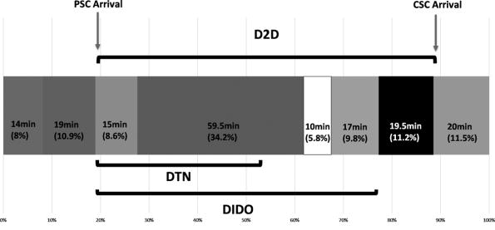
Reducing time intervals in metropolitan areas Deconstruction of interhospital worflow Ng eta al Stroke 2017
Door in-door out (DIDO) at PSC : The longest component of DIDO was CT-to-retrieval request (56.1% of DIDO) where tasks performed include imaging acquisition, reconstruction, and and interpretation
interhospital transfers(D2D) exceed 2 hours even in highvolume PSCs in the evidence-based thrombectomy era

Slide 16
EFFICIENT DELIVERY
Bypass PSC if CSC in a radius of 20miles
Transfer if PSC is able to achieve DIDO<40 minutes
P2P <90 minutes
Unless increase the number of CSC
Patients with suspected ELVO primarily transported to non-endovascular-capable centers owing to large transport time differences or clinical instability should undergo expeditious evaluation and treatment, including non-contrast head CT, possible vessel imaging immediately upon arrival, and administration of IV t-PA (if eligible).
Vessel imaging should not delay patient transfer. Rapid transfer to a comprehensive center with endovascular capability to minimize interhospital transfer delays is a priority.
A metric proposed to assess transfer processes is the picture to puncture (P2P) time. A P2Pof <90 min should be a goal. (AHA class I, level of evidence C)
Standarts and guidelines from SNIS Pride et al. J NeuroIntervent Surg 2017;9:802–812

Slide 17
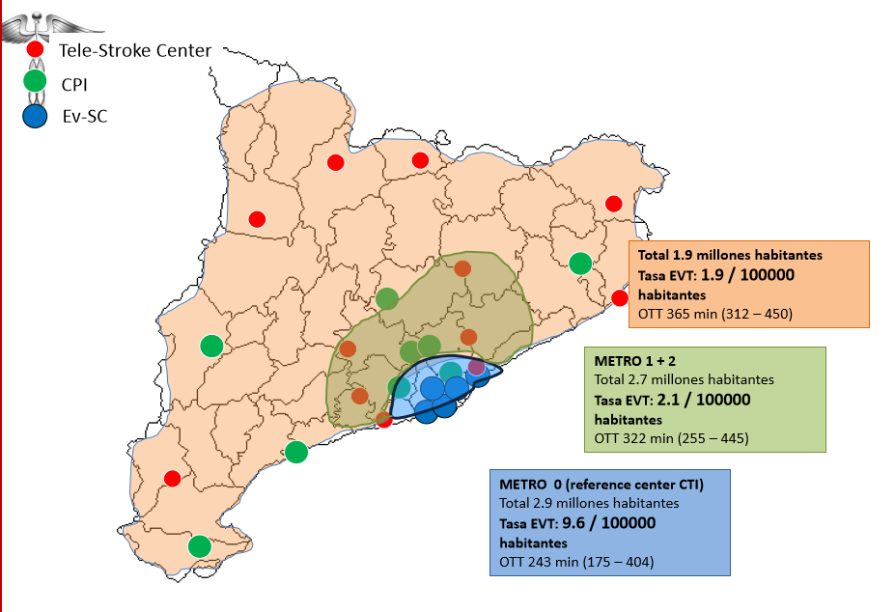
Registry of Catalonia:Geographical inequity

Slide 18
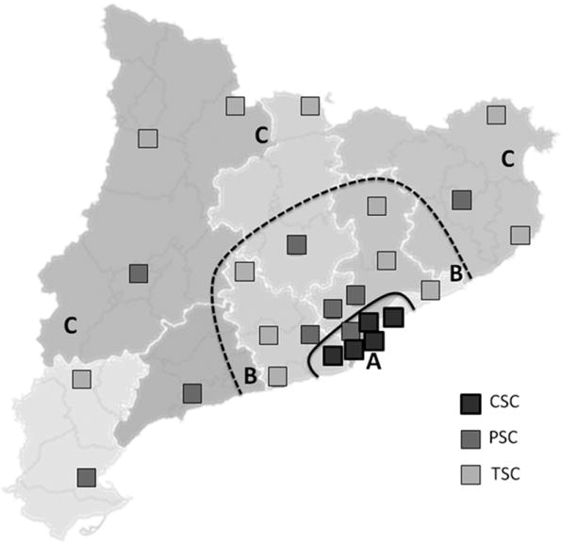
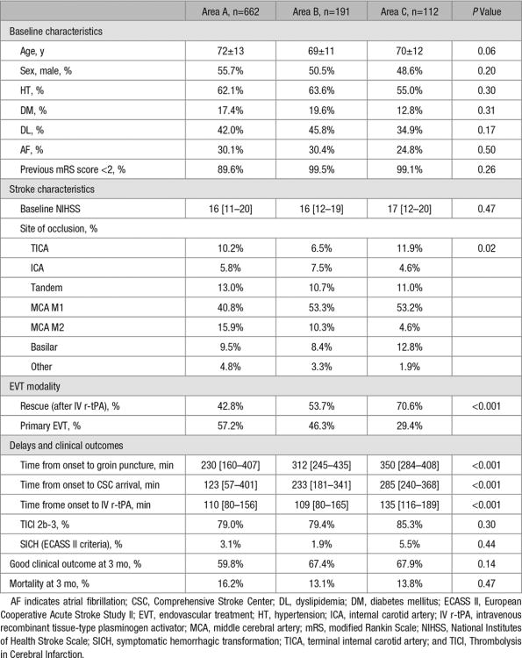
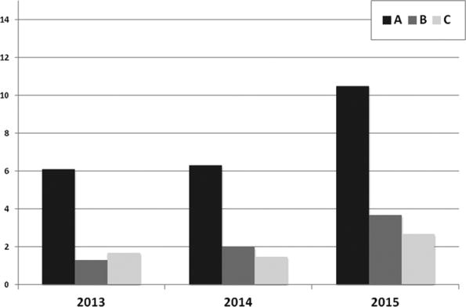
Geographic differences in acute stroke care in Catalunya: impact of a regional interhospital network .Ribo et al. Cerebrovascular diseases 26:284-288, 2008
An interhospital network based on transfers to CSC does not warrant geographical equity: equal access to best therapeutic Interventions is only partially achieved at the expense of a high proportion of unecessary transfers.
Access to Endovascular Treatment in Remote Areas: Analysis of the Reperfusion Treatment Registry of Catalonia.
Perez de la Ossa, Natalia;
Stroke. 47(5):1381-1384, May 2016.

Slide 20
Interfascility MT Acessibility(within 6h) for distant PSC patients.
A3year prospective registry analysis
Causes of non-transfer, n 92 (43.6%)
Time out | 42 (45.6%)
Age over 80 or comorbidity | 27 (29.3%)
Protocol deviation* | 10 (10.9%)
Unknown | 6 (6.5%)
Unavailable quick transport | 3 (3.3%)
Clinical improvement | 2 (2.2%)
meteorological red alert | 2 (2.2%)
Thrombectomy accessibility after transfer from a primary stroke center: Analysis of a three-year prospective registry . Sablot et al. IJS 12:519-523 ;2017

Slide 21
Interfascility MT Acessibility(within 6h) for distant PSC patients.
A3year prospective registry analysis
Causes of futile transfer, n67 (56.3%)
Clinical improvement or reperfusion on MRI | 31 (46.2%)
Time out after transfer | 16 (23.9%)
Clinical worsening or infarct growth | 10 (14.9%)
Protocol deviation | 4 (6%)
Randomization in the medical treatment arm | 2 (3%)
Transfer due to expected worsening | 2 (3%)
Other | 2 (3% )
Thrombectomy accessibility after transfer from a primary stroke center: Analysis of a three-year prospective registry . Sablot et al. IJS 2017;12:519-523

Slide 22
Thrombectomy accessibility after transfer from a primary stroke center: Analysis of a three-year prospective registry . Sablot et al. IJS 12:519-523

Slide 23
Thrombectomy accessibility after transfer from a primary stroke center: Analysis of a three-year prospective registry . Sablot et al. IJS 2017 ;12:519-523

Slide 24
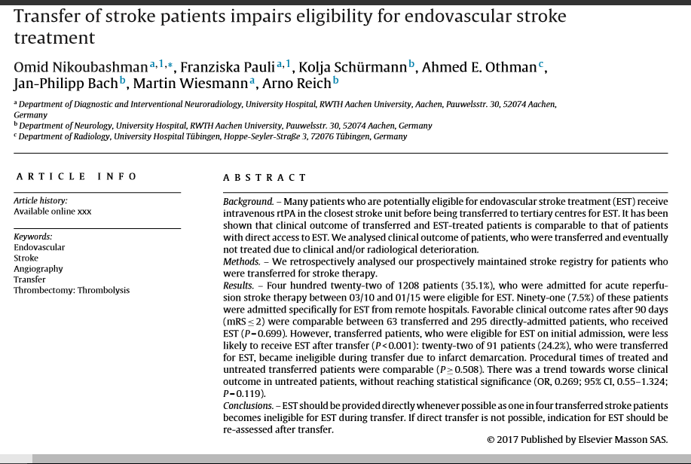
24.2% of initially eligible patients became ineligible after transfer due to infarct progression

Slide 26
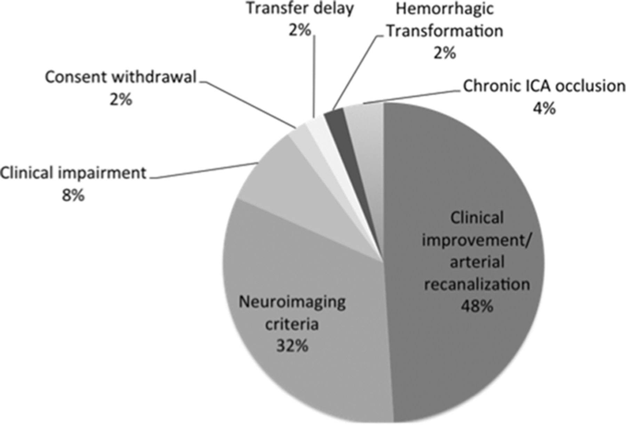
Reasons for the futile transfer.
Blanca Fuentes et al. Stroke. 2015;46:2156-2161
Copyright © American Heart Association, Inc. All rights reserved.
Notes:
Reasons for the futile transfer. ICA indicates internal carotid artery.

Slide 27
Drip and Ship Versus Direct to Comprehensive Stroke Center Conditional Probability Modeling Holodinsky et al Stroke .2017;48:233-238
Theoretical models were built on recanalization rate of 74% for EVT and 18% for IVT
in case of a transfer time superior to 45 minutes between the PSC and the CSC,
if the patient is close to a PSC, DS paradigm is better than MS

Slide 28
Regional Distribution of CSC
Equity, Access, Address geographical differences
We can’t ignore Transfer related mortality
Requirements
Less PSC and more CSC, with large volumes of patients with AIS and endovascular capability
Stroke volume ()
Site accreditation
Physician certification
Davis et al. Stroke 2017.48:2042-2044

Slide 29
EVT Capability Must Expand Beyond Our CSC Training Centers
Is it better for a patient to be treated in regional hospital stroke centers covered by a VNs who does EVT than to take the extra ≥2 hours required for transfer to a CSC?
EVT can be provided at regional stroke centers by VNs who are appropriately trained and who have created a team of nurses, anesthesiologists, technologists, radiologists,and stroke unit personnel to take care of the patient.
although thorough and expert training in all aspect of neurovascular intervention is required, we suggest that it might not be necessary that all VNs carrying out EVT outside of CSCs maintain skills to treat aneurysms, AVMs and other non-ET cases
(Stroke. 2017;48:2313-2317)

