Slide 1
Complex Strokes and Strokes of Unknown Etiology
Michelle Kearney, MSN, RN, ACNP-BC

Slide 2
Disclosures
No financial disclosures
Sub-Investigator
Stroke AF trial
RESPECT-ESUS trial

Slide 3
OBJECTIVES
Identifying the signs and symptoms of a posterior circulation stroke
Discuss the best work-up for hard-to-diagnose strokes
Discuss treatments for posterior circulation strokes
Discuss the interventions for cryptogenic stroke

Slide 4
”Where I come from…it’s cornbread and chicken…”
Notes:
Okay, back to the case study: here’s the newest scan and the scenario. What’s happening?

Slide 5
Posterior Circulation Strokes
Confounding symptoms
Mimic other medical problems
Posterior circulation vessels supply very diverse regions
Posterior parts of the cerebrum to the brainstem and cerebellum
Greater than 20% of these strokes are missed in the ED and the patients are sent home
Are nearly 3x more likely that “anterior” circulation strokes to be missed
Early recognition=Early intervention=Best recovery chance
Occlusion of the large vessels in this area has a mortality risk of 85%
Think: Basilar=Brainstem

Slide 6
Common Symptoms
Deadliest of D’s
Other Symptoms
Dizziness
Diplopia
Dysarthria
Dysphagia
Dysphonia
Dysmetria
Dysthesia
Drop Attacks (DFO)
Dystaxia
Altered mental status
Tinnitus
Nausea
Vomiting
Vertigo
Facial numbness
Perioral numbness
Nystagmus
Cross symptoms
Unilateral or bilateral sensory loss
Unilateral or bilateral hemiparesis
Quadraperesis
Notes:
Symptoms; I mean, how can you miss that??!!

Slide 7
The posterior cerebral arteries stem in most individuals from the basilar artery but sometimes originate from the ipsilateral internal carotid artery.
The posterior arteries supply the temporal and occipital lobes of the left cerebral hemisphere and the right hemisphere.

Slide 8
Big Deal?
Cranial Nerve Exam
Pupil light reflexes
Visual fields
Facial symmetry
Voice
Tongue deviation
Sensation
Palate elevation
Gag reflex
Head turning and shoulder shrug
BRAINSTEM
Most of the cranial nerves are here
Impairment:
Motor or sensory loss in all 4 limbs
Crossed signs (face vs. body)
Nystagmus
Ataxia
Dysarthria
Dysphagia
Respiration
Living

Slide 9
Clinical Assessments: “It ain’t right”
LAMS (Arm, Grip, Facial Droop)
Cincinnati (Facial Droop, Arm, Speech)
FAST-ED (Face, Arm Speech, Eye Deviation, Denial/Neglect)
RACE (Face, Arm, Leg, Head/Eye Deviation, Aphasia, Agnosia/Neglect)
BE FAST
Balance + Eyes
NIHSS
Mostly for anterior strokes
Weakness
Ataxia
Visual deficits
Gaze
Have the patient
Swallow and Speak
Eye Exam
Nystagmus? Deviations?
CN Exam
Define Dizziness
Ear roaring? Med Changes? Dimming vision?
Test the Gait!!
How often do you walk your patients in the ED?
Should you discharge him/her before seeing that?
What about some clinical decision support tools?
Notes:
Sometimes, when you pick a person up, as we say, “they just don’t seem right”
Have him/her swallow. Check the eyes. Full strength but they just “aint right”
What about a Xarelto patient? Destination guidelines in the state? Do you have to think about not going to a PSC?
Race: rapid arterial occlusion evaluation scale
Define Dizziness
Target questions
Does the room spin
Is there an aura or preceding feeling prior to be “dizzy”?
Is there a dimming of your vision?
Roaring in your ears?
Ringing in your ears?
Balance? (have the patient walk)
Feel drunk? Weak? “Woozy?”
Any new medication changes?
BP med changes?
Trips?
Reasons for dehydration?
Illness?

Slide 10
Cranial Nerve Exam
Pupil light reflexes
Visual fields
Facial symmetry
Voice
Tongue deviation
Sensation
Palate elevation
Gag reflex
Head turning and shoulder shrug

Slide 11
Etiology
Ischemic
Hemorrhagic
Vert dissection
Large vessel plaques:
Vertebral origins
Dissections where the artery enters the skull
Small vessel disease
Embolic infarcts
PFO, ASD
Endocarditis
Afib
Basilar Tip aneurysms
HTN
Drug use
Alcohol
Trauma

Slide 12
The Stroke Work-up
CT…
Do we do it for the ones listed later? Dizzy—get a CT?
Bad News: CT has poor resolution in the posterior fossa
12% false negatives
NIHSS testing
MRI
Can miss a small posterior fossa stroke but it’s better than CT
CTA/Perfusion
Many CTA/P will not give you an accurate penumbra in the posterior fossa
Thrombus?
Dissection?
Notes:
Anything in this that you suspect isn’t always done for this patient?
In the field?
In the ED?
In the hospital?
In the doctor’s office?

Slide 13
DDX: A miss=Disaster
Benign Paroxysmal Positional Vertigo, Migrainous Vertigo, Vestibular Neuritis=labrynthitis (also tinnitus)
Meniere’s Disease
Cerebellar Infarction
Cerebellar Hemorrhage
Demyelinating disorders
Vertebrobasilar Insufficiency
Infection; Toxins/Metabolic Issues; Medications
Brain Tumors/mets/Cerebellar neoplasm
Conversion Disorder
Seizure w/postictal paralysis
Epidural/subdural hematoma
Missed Diagnosis=Disaster
Notes:
Okay, of these diagnoses, which could have those symptoms?
All Differentials are not the same. Which ones are worse if you miss them?

Slide 14
If you miss it
No tpa
No MER
50% of the patients show up inside of the treatment windows
Increased LOS
Stroke Coordinator nightmares (and those nasty letters to providers)
Missed metrics
Discharge differences
SNF instead of IPR
Double readmission rates
Increased morbidity and mortality

Slide 15
Case Study
60 year old male
Tobacco, alcohol, DM, HTN, chronic Afib on Xarelto and a beta blocker for rate control
Symptoms began: 1530
Headache, Nausea, Vomiting, Dizziness
OSH at 1630
AF on arrival with RVR—Immediate treatment of his AF, rate control with Cardizem drip
2145-Stopped speaking, Right hemiparesis
Telemedicine consult-wife declines tPA
2215-Begins posturing “like a seizure”
No longer protecting airway-intubated
They call the helicopter
2330-Arrival to the CSC
Believe symptoms began about 1530
Notes:
At risk for stroke?
Could these be from a virus? Afib? He went to his PCP
PCP sent him to OSH ED
Declines tPA
Neurologist thinks the symptoms probably started at 1530
We do a CTA—
Presented to OSH with reports of dizziness, etc.
Went to his PCP
Sent to OSH
RVR on arrival
Mental status change

Slide 16
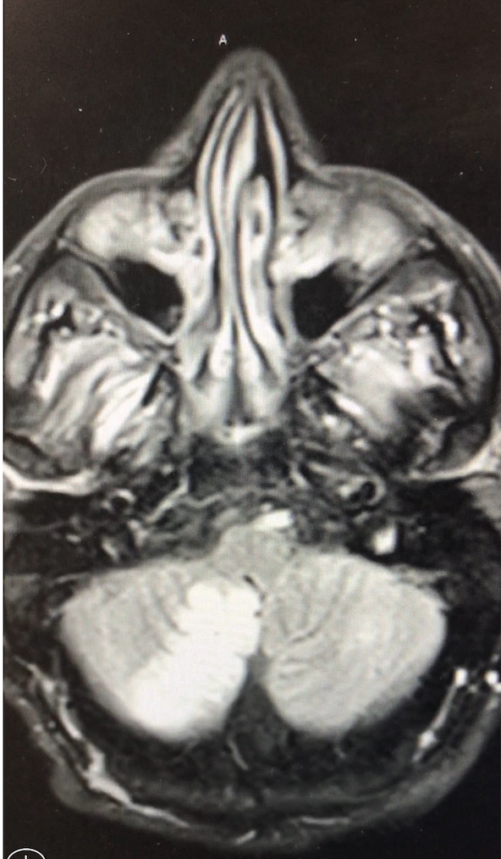
CTA on arrival:
Right vertebral artery=Occluded
Basilar artery=proximal 2/3 occluded
Early ischemia in the right cerebellar hemisphere
This is the initial MRI

Slide 17
Management
Day 1
No neuro responses NIHSS 31
Day 3
Blinks to responses, No motor
Neurology
OOW for tpa due to likely onset of symptoms (possibly started at 1530)
Wife declined tPA anyway
STAT Neurosurgical Consult
Mechanical Thrombectomy-not done
Cited risk of hemorrhage and death in cerebellum with established stroke
Cerebellar hemorrhage risk
Management:
Heparin drip
Avoid hypotension
Continued treatments
Craniectomy watch
Palliative Care Consults

Slide 18
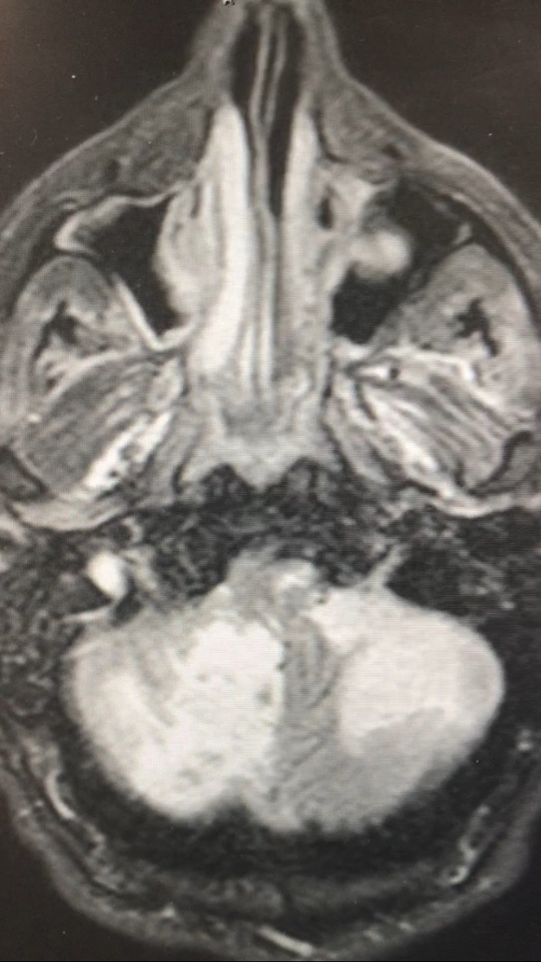
Assessment:
All reflexes gone
This is the repeat MRI

Slide 19
So, it went too far…
Osmotic Diuretics
Mannitol 0.5-1.0 gm/kg
10-20 mL of 23.4% NaCl
Volume expansion for cerebral blood volume circulation
3% NaCl
Albumin
Steroids—more in tumors
Lowers CSF production
Decrease BBB permeability
Sedatives to decrease metabolic activity
Barbiturates
Diprivan, opiates, etc
Notes:
What are our options for treatment?

Slide 20
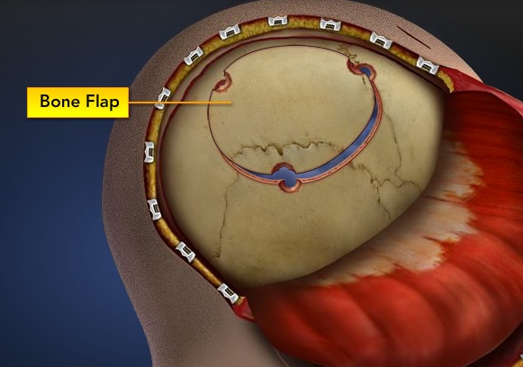
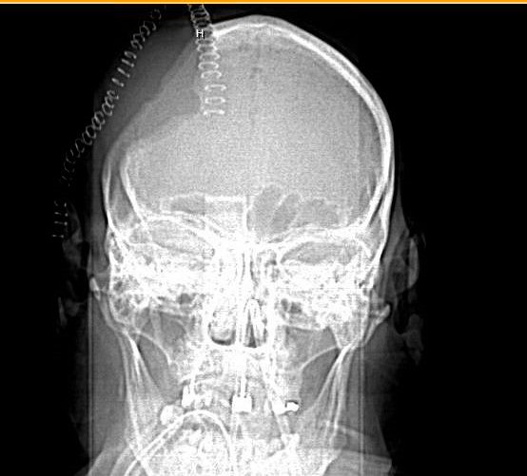
Neurosurgical Treatments
Craniectomy
Named by the bone plate/area removed
Large ischemic area

Slide 21
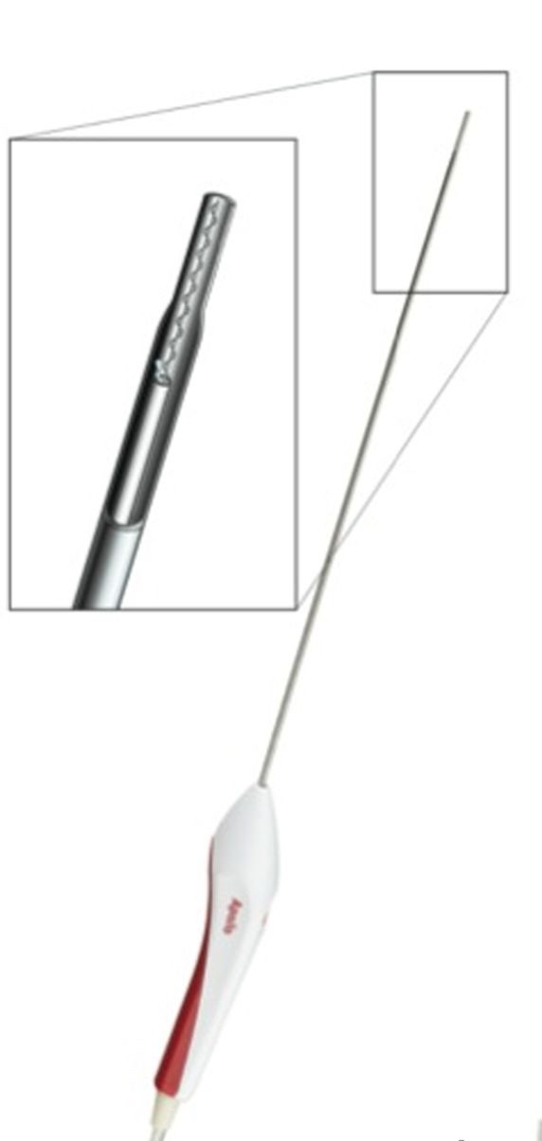
Hematoma evacuation
-Hemorrhage 3-4cm
-Brainstem compression
-Posterior fossa
Craniotomy
Clot is evacuated
Bone flap replaced
Endoscopic aspiration
David Fiorella et al. J NeuroIntervent Surg doi:10.1136/neurintsurg-2014-011293

Slide 22
External (intra)ventricular drain (EVD)

Slide 23
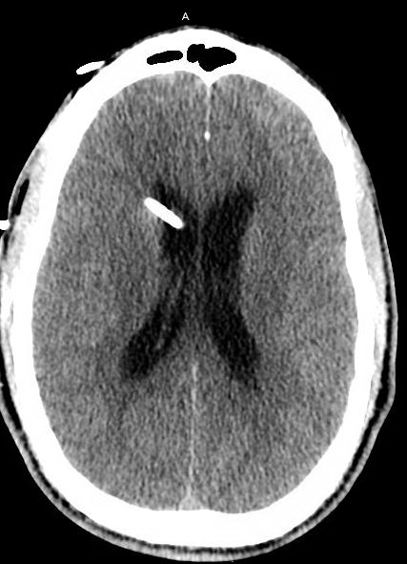
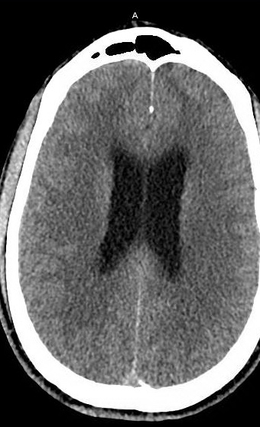
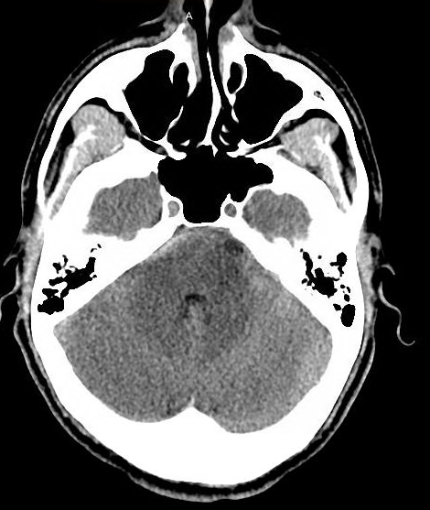
Hydrocephalus
Notes:
Look at the ventricles; big or small?
What about this 4th ventricle? Blood? What does that mean?
Now look.
When can we remove it? What will we do to know? (Clamp trials, CTs, Monitor ICP)

Slide 24
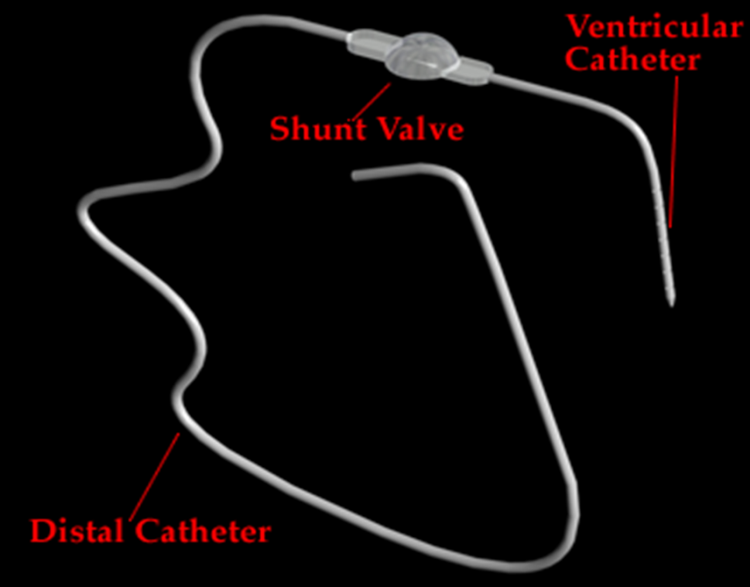
Ventriculoperitoneal Shunt
Notes:
What if the patient fails the EVD clamp trial??

Slide 25
What if it isn’t a stroke……
What if it turns out to be just dizziness? Or another mimic
Neurology 2010 study (Chernyshev, et al., 2010):
512 patients received tPA
On f/u imaging, 21% did not show an infarct
Median NIHSS 7 on admit, 0 at discharge
No sICH
Independent at discharge (median LOS 3 days)
Most frequent mimics:
Seizure, conversion, migraine
Notes:
What if we think it COULD be a stroke or a migraine? And the person wants tPA?

Slide 26
Cryptogenic Stroke

Slide 27
Case Study
57 year old man (CAD, stents, H/O TURP 2006, recent hematuria
On ASA and Plavix
Confused while driving for 2 hours AND 2 weeks of “wavy or glittery vision”
HTN meds recently increased–
Arrives at 1430
CT negative
Symptoms improved, NIHSS 0
BP 190/110
DDX:
TGA
HTN Encephalopathy
TIA

Slide 28
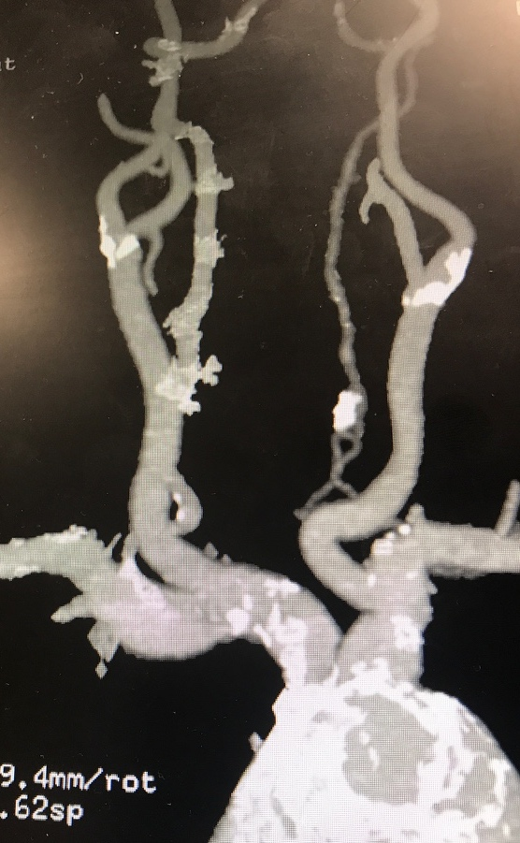

Slide 29
The Work-up (Hint: it’s the same as for any stroke)
Imaging
CT
MRI
CUS
CTA/MRA (Always done on a TIA??)
Cardiac Evaluation
TTE or TEE
Age dependent
Suspicion for embolic events high/low
Telemetry
NIHSS
Neuro Checks
CTA
Distal left vertebral artery 80+% stenosis
50% stenosis of right vertebral artery
50% or less of carotids
MRI
Multiple & Diffuse tiny acute ischemic strokes in the posterior circulation
One cortical stroke supplied by the RMCA
TEE
LV normal with EF 64%
All chambers normal
No ASD or PFO or Thrombus
Mild athero of descending aorta

Slide 30
Cryptogenic: Embolic with no real source identified
Maximal Medical Management
Dual antiplatelets
Failed this already
Placed him on Aggrenox and ASA
High dose atorvastatin
Endovascular angioplasty of vertebral artery?
Only if fails medical management
Vertebral artery angioplasty/stenting would be an option
Prolonged ECG monitoring
AHA Guidelines: “up to six months after stroke”
ESC 2016 AF Guidelines

Slide 31
Missing cryptogenic stroke or AF
What’s the big deal?
Atrial Fibrillation
Largest strokes
Most debilitating
Likelihood of next stroke is high
Different treatments
Antiplatelets
Anticoagulation
No OAC
AF on OAC: approaches 65-80% protected
AF on antiplatelet: approaches 20% protected
Readmission

Slide 32
Implantable Loop Recorder

Slide 33
Management Post Discharge
Continuous ECG monitoring post discharge
Inpatient telemetry isn’t enough
How long?
7-day? 14-day? Longer with implantable monitor?
Cryptogenic Stroke Pathways
Inpatient?
Outpatient?
Who is responsible?
Referrals?
Neurology and Cardiology have to talk
Administrative approval
Where will you do it inpatient
Financially, figure out if it’s better INPT or OUTPT
Volumes are growing, new guidelines
Can your implant team handle it?

Slide 34
Unanswered questions
No AF in 3 months?
Then, see ya?
CRYSTAL AF says averages 84 days
Who follows the patient?
Stroke Clinic?
Neurologists?
EP Team?
NPs?
Now what??
OAC given?
By whom?

Slide 35
Questions? --Reach out!
Michelle Kearney, MSN, ACNP-BC
Nashville, TN
Michelle.kearney@sth.org
mkearney711@gmail.com
615-310-5527

Slide 36
References
AANN Clinical Practice Guideline Series; Guide to the Care of the Hospitalized Patient with Ischemic Stroke (2nd edition)
Adams et al. (2013) Guidelines for the early management of patients with ischemic stroke
American Heart Association (2015) Comments, 2015|Blog|20. (2015, June 29). Guidelines urge new approach to treating worst strokes. Retrieved March 17, 2016, from http://news.heart.org/guidelines-urge-new-approach-to-treating-worst-strokes/
American Heart Association. (2016). What’s at the heart of my cryptogenic stroke? A patient’s guide to understanding strokes of unknown cause. American Heart Association. Retrieved from http://www.strokeassociation.org/idc/groups/stroke-public/@wcm/@hcm/@sta/documents/downloadable/ucm_477655.pdf
AO Surgery Reference (www2.aofoundation.org)
Caplan, L. R. (1996). Posterior Circulation Disease: Clinical Findings, Diagnosis, and Management. Cambridge, Massachusetts: Blackwell Science.
Culebras, A., Messe, S. R., Chaturvedi, S., Kase, C. S., & Gronseth, G. (2014). Summary of evidence-based guideline update: prevention of stroke in nonvalvular atrial fibrillation: report of the Guideline Development Subcommittee of the American Academy of Neurology. Neurology, 82(8), 716–724. https://doi.org/10.1212/WNL.0000000000000145
Craniotomy. (2015, May). Retrieved fromhttp://www.slideshare.net/maekrasniewic/craniotomy
Gladstone, D. J., Spring, M., Dorian, P., Panzov, V., Thorpe, K. E., Hall, J., … Mamdani, M. (2014). Atrial fibrillation in patients with cryptogenic stroke. The New England Journal of Medicine, 370(26), 2467–2477. https://doi.org/10.1056/NEJMoa1311376
Grond, M., Jauss, M., Hamann, G., Stark, E., Veltkamp, R., Nabavi, D., … Kirchhof, P. (2013). Improved Detection of Silent Atrial Fibrillation Using 72-Hour Holter ECG in Patients With Ischemic Stroke. Stroke, 44(12), 3357–3364. https://doi.org/10.1161/STROKEAHA.113.001884
Hepburn-Smith, M., Dynkevich, I., Spektor, M., Lord, A., Czeisler, B., Lewis, A. (2016). Establishment of an External Ventricular Drain Best Practice Guideline: The Quest for a Comprehensive, Universal Standard for External Ventricular Drain Care. Journal of Neuroscience Nursing. 48(1), pp54-65.
Jouria, J. & Katz, M.J. (2013) . Stroke: comprehensive Acute Stroke Care. Wild Iris Medical Education , Inc. (http://www.nursingceu.com/courses/422/index_nceu.html)
Kirchhof, P., Benussi, S., Kotecha, D., Ahlsson, A., Atar, D., Casadei, B., … Zeppenfeld, K. (2016). 2016 ESC Guidelines for the management of atrial fibrillation developed in collaboration with EACTS. European Heart Journal, 37(38), 2893–2962. https://doi.org/10.1093/eurheartj/ehw210
Lip, G. Y. H., Hunter, T. D., Quiroz, M. E., Ziegler, P. D., & Turakhia, M. P. (2017). Atrial Fibrillation Diagnosis Timing, Ambulatory ECG Monitoring Utilization, and Risk of Recurrent Stroke. Circulation: Cardiovascular Quality and Outcomes, 10(1), e002864. https://doi.org/10.1161/CIRCOUTCOMES.116.002864
Meschia, J. F. (2008). Decoding cryptogenic cardioembolism. Annals of Neurology, 64(4), 364–366. https://doi.org/10.1002/ana.21470
Ropper, Samuels & Klein (2014). Adams and Victor’s Principles of Neurology (10th ed.). McGraw Hill. New York
Sanna, T., Diener, H.-C., Passman, R. S., Di Lazzaro, V., Bernstein, R. A., Morillo, C. A., … Brachmann, J. (2014). Cryptogenic stroke and underlying atrial fibrillation. The New England Journal of Medicine, 370(26), 2478–2486. https://doi.org/10.1056/NEJMoa1313600
Summers, D., Leonard, A., Wentworth, D., Saver, J., Simpson, J., Spilker, J.,……Mitchell, P. (2009). AHA Scientific Statement: Comprehensive Overview of Nursing and Interdisciplinary Care of the Acute Ischemic Stroke Patient. Stroke. 2009, 40:2911-2944).
Tomson, T. T., Greenland, P., & Passman, R. (2014). The Impact of Early Detection of Atrial Fibrillation on Stroke Outcomes. Cardiac Electrophysiology Clinics, 6(1), 125–132. https://doi.org/10.1016/j.ccep.2013.10.008
Tu, H. T., Spence, S., Kalman, J. M., & Davis, S. M. (2014). Twenty-eight day Holter monitoring is poorly tolerated and insensitive for paroxysmal atrial fibrillation detection in cryptogenic stroke. Internal Medicine Journal, 44(5), 505–508. https://doi.org/10.1111/imj.12410
Schattner, A., & Hadad, A. (2014). Cryptogenic stroke, atrial fibrillation and primary prevention. European Journal of Internal Medicine, 25(10), e124. https://doi.org/10.1016/j.ejim.2014.10.027
Yong, J. H. E., Thavorn, K., Hoch, J. S., Mamdani, M., Thorpe, K. E., Dorian, P., … Gladstone, D. J. (2016). Potential Cost-Effectiveness of Ambulatory Cardiac Rhythm Monitoring After Cryptogenic Stroke. Stroke, 47(9), 2380–2385. https://doi.org/10.1161/STROKEAHA.115.011979

