Slide 1
Case #2
A 43yo woman presents with Hunt and Hess 2, Fisher 3 SAH:
5mm left PComm aneurysm
2mm Acomm aneurysm
Spetzler-Martin grade 4 L parieto-occipital AVM

Slide 4
43yo woman presents with Hunt and Hess 2, Fisher 3 SAH 5mm LPComm aneurysm, 2mm Acomm aneurysm and a S-M4 L parieto-occipital AVM

Slide 5
Poll: The Best Course of Action Is?
Craniotomy for clipping of both aneurysms
Right-sided craniotomy for clipping of Acomm aneurysm only
Left-sided craniotomy for excision of the AVM and clipping of both aneurysms
Coiling of Pcomm aneurysm
Coiling of Acomm aneurysm
Coiling of both aneurysms
Coiling of both aneurysms and embolization of the AVM

Slide 6
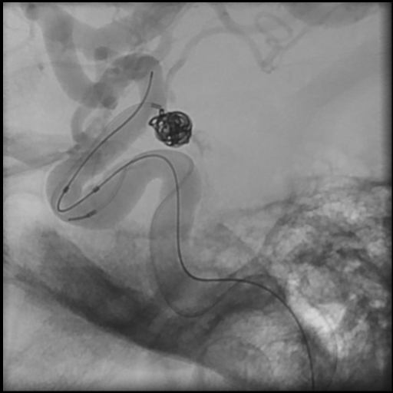
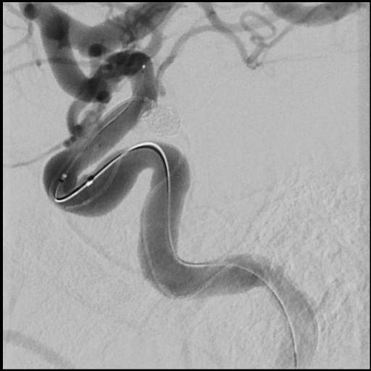
The decision is made to coil the left Pcomm and explore the possibility of coiling the Acomm also. A hydroframe 5x15 is chosen and this is placed with balloon assistance. A hydrosoft 3x6 is placed and the aneurysm is deemed reasonably well coiled.

Slide 7
45 minutes is spent attempting the catheterize the Acomm aneurysm from both sides.
The aneurysm is small and the access is tortuous.
I begin to get the feeling that I might hurt her if I keep trying to get a catheter into this small Acomm aneurysm.

Slide 8
Poll: The Best Course of Action Is?
Right-sided craniotomy for clipping of Acomm aneurysm emergently
Right-sided craniotomy for clipping of Acomm aneurysm when best OR team is available, within next 2 days
Medical management through the vasospasm period before any further treatment because the larger aneurysm is treated.
Craniotomy for excision of AVM and clipping of Acomm aneurysm
Persist in attempting to coil the Acomm aneurysm using other techniques

Slide 9
She is awakened from the coiling, and has no deficits.
The Acomm aneurysm is clipped from the right side and fresh subarachnoid clot is seen on the aneurysm.
She awakens from the craniotomy aphasic and hemiplegic on the right.

Slide 11
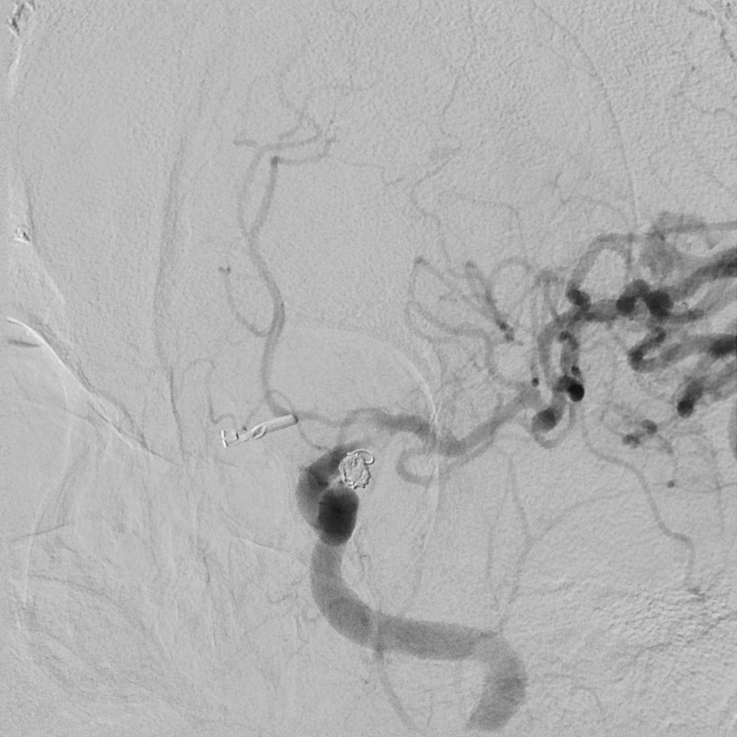
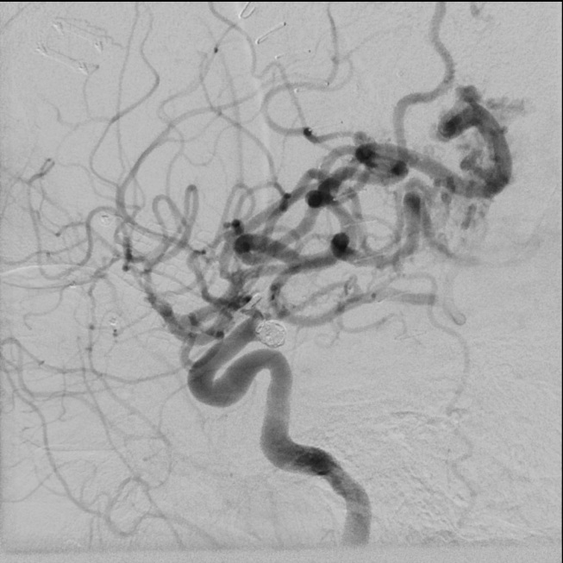

Slide 12
This is what the coils looked like at the end of coiling- I missed the clot seen on the coil at the aneurysm neck and the significant movement of the coil.

Slide 13
4mg abciximab is infused directly into the clot through a microcatheter with some improvement and an IV abciximab drip is started. The RICA is checked and the aneurysm is well clipped without other issues. When the diagnostic catheter is returned to the left, the clot seems to be worsening and progressing towards occlusion.

Slide 14
A stent is deployed with good resolution of the clot and the patient is awakened.
She has an incomplete MCA stroke, but significant aphasia and hemiparesis.

Slide 15
Lessons:
I should treat the aneurysm that I believed ruptured and that judgement should be made on the basis of aneurysm morphology, not size.
It is stupid to be over-aggressive with coils in a SAH patient, particularly if they have other problems (AVM, multiple aneurysms)
I need to pay attention. The coils moved. A 3D dual-volume dynaCT might have shown vessel impingement. Its better to know and we have good imaging tools to inspect what we have done.
I don’t actually regret avoiding the left-sided craniotomy, nor that I stopped trying to catheterize the Acomm aneurysm.

